Slide 1

BIOLOGICAL ACTION
Biological action for cleaner soil, water, and coastlines.
Lenoil®
Oil-degrading biological products by BIOMEDHIM
Biological remediation for oil-contaminated environments

Slide 2
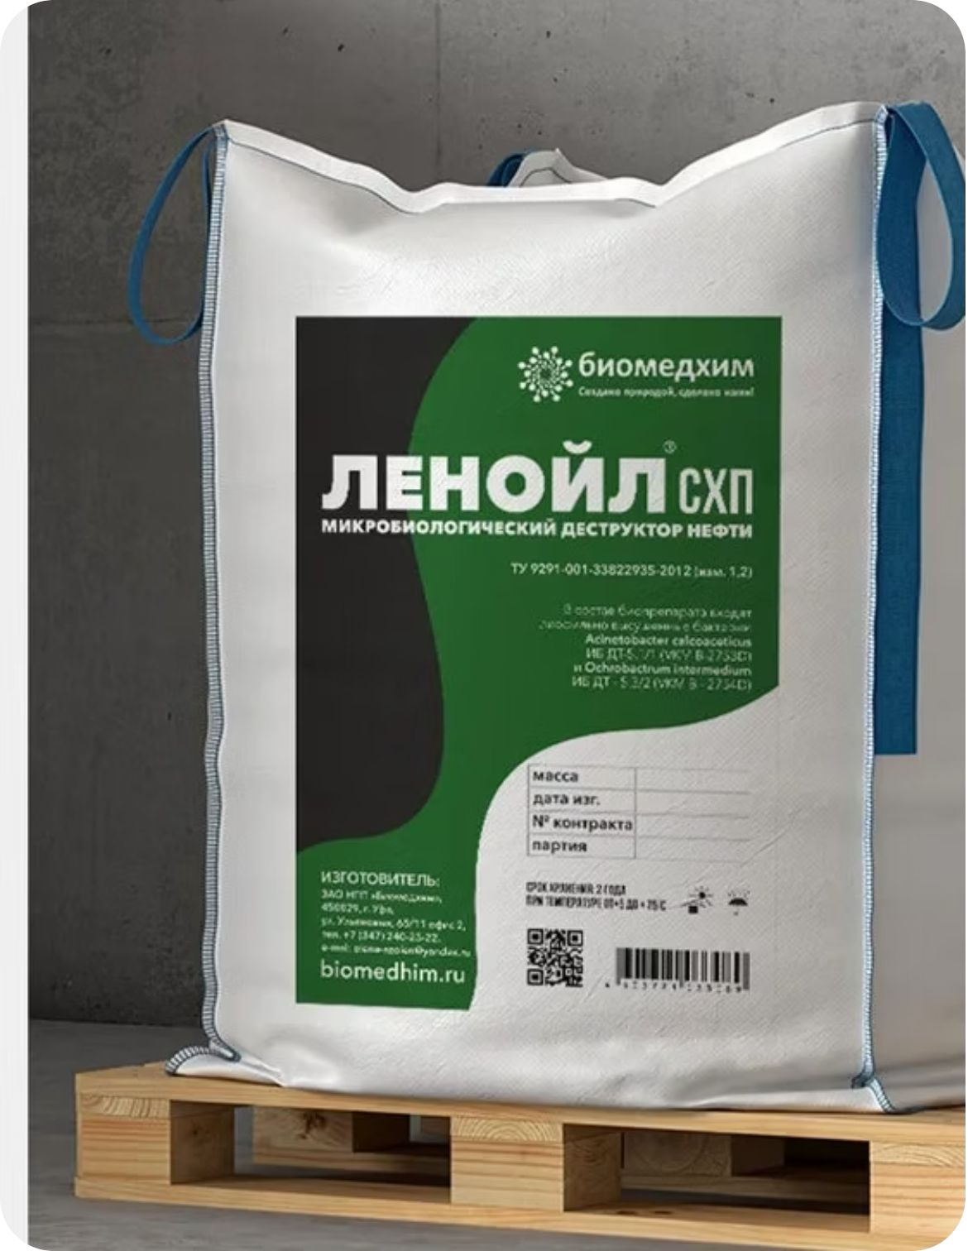




BIOMEDHIM · BIOLOGICAL REMEDIATION
Lenoil®: biological degradation of oil pollution
Treats oil-contaminated soils, grounds, and water surfaces.
Application
Broad operating window
Treats oil-contaminated soils, grounds, and water surfaces.
Processes linear, branched, cyclic, and polyaromatic hydrocarbons above 60 g/l, across 3–45°C, at concentrations up to 50%.
Environmental conversion
Lenoil®–NORD
Hydrocarbons are processed into environmentally safe compounds, carbon dioxide, and water.
Cold-climate option: oil degradation begins from 0°C, including use in low positive temperatures.

Slide 3
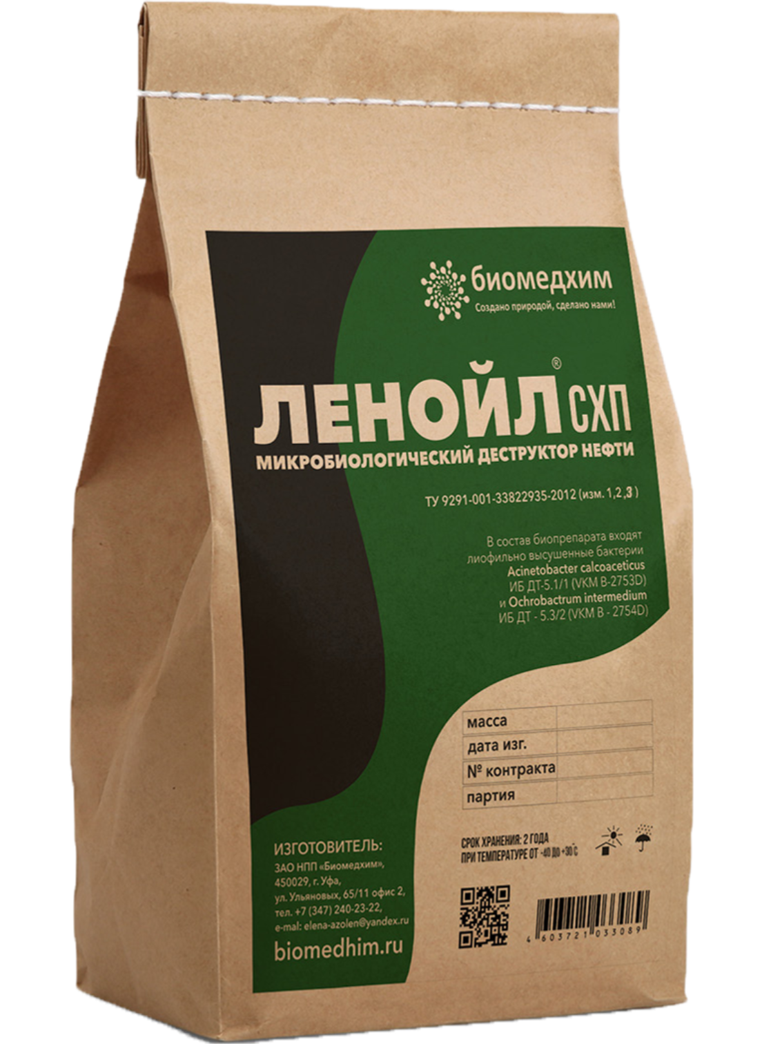
BIOMEDHIM · OIL-POLLUTION TREATMENT
Oil-degrading biological products® — Lenoil™
Industrial-purpose biological agents: Lenoil® Dry Powder and Lenoil®–NORD.
Lenoil® Dry Powder
Lenoil®–NORD
Processes petroleum products containing linear, branched, cyclic, and polyaromatic hydrocarbons in highly mineralized environments above 60 g/l, across 3–45°C, and at concentrations up to 50%.
For oil-contaminated soils, grounds, and water surfaces in the low positive temperatures of the Far North and Western Siberia.
Microorganisms degrade petroleum hydrocarbons in highly mineralized environments over a wide temperature range.
Produces environmentally safe compounds, carbon dioxide, and water.
Distinctive feature
The biological products can fix atmospheric nitrogen and convert it into an easily accessible form, supporting hydrocarbon utilization when additional nitrogen is needed.

