Slide 1

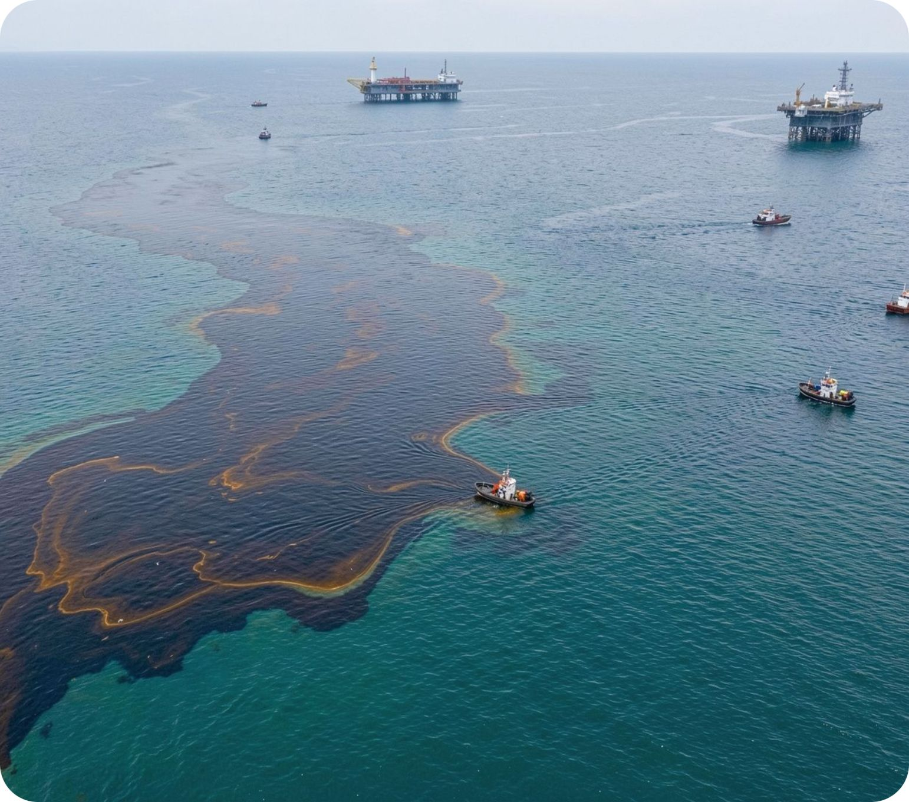
DIMEX
for marine oil-spill response
A solid dispersant developed for eliminating oil spills on marine waters, including winter and ice conditions.
SOLID DISPERSANT
MARINE WATERS

Slide 2

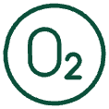



WHY DISPERSANTS MATTER
Protects wildlife
Reduces shoreline harm
Reduces oil adhesion to bird feathers and marine-mammal coats, helping protect them from contamination and death in the oil slick.
Lowers the harmful impact of oil on shorelines and coastal structures.
Accelerates natural breakdown
Prevents “chocolate mousse”
A much larger contact area with oxygen and oil-oxidizing bacteria speeds the natural decomposition of spilled oil.
Helps prevent the formation of persistent oil agglomerates.
Works in difficult conditions
Reduces wind transport
Can be used when other response methods are constrained: wave height above 1.5 m, strong currents, and wind speeds up to 15 m/s.
Sharp reduction in the amount of oil remaining on the surface and exposed to wind-driven transport across the sea.

Slide 3
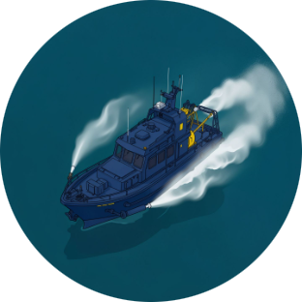
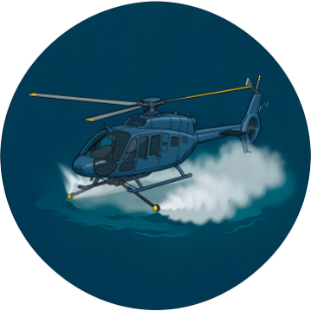
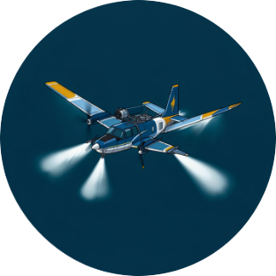
THREE APPLICATION ROUTES
Vessel
Helicopter
Aircraft
Precise application with adjustable dosage. Processing speed is lower than with aviation assets.
Aviation application increases the area that can be treated in a short time.
Large transport aircraft with dedicated spray equipment deliver the highest processing productivity.
The least effective approach is using a vessel fire main with dispersant injected into the flow.
Application choice balances precision, coverage, and processing speed.

Slide 4
DIMEX · RESPONSE WINDOW
1
2
Wider operating window
Faster treatment
More flexibility than mechanical methods across weather and hydrometeorological conditions, and across the amount of oil-spill equipment and machinery deployed.
Rapid processing of contaminated water, especially with aviation assets.
3
4
Non-toxic materials
Different mechanism
Developed from non-toxic materials using natural mineral compounds.
Fine powders of insoluble natural materials stabilize emulsions, while non-synthetic surfactants provide the preparation’s emulsifying effect.
5
6
High dispersing activity
Cold-water capability
Effective for removing surface films of oil, kerosene, gasoline, and diesel fuel from water.
Operates in the surface water layer from –2°C, with slush and ice present, to +25°C.

Slide 5
The composition uses natural mineral compounds capable of forming stable suspensions, including in water–oil systems. The technical result is supported by the effectiveness and safety of the components used in the formulation.
DIMEX · THIRD-GENERATION DISPERSANT
Stable suspensions.
Effective and safe components.
Based on natural organo-inorganic hybrid materials, DIMEX represents a new promising class of preparations for addressing the consequences of oil spills.
Unlike traditional liquid dispersants, fine powders of insoluble natural materials act as effective emulsion stabilizers, while the non-synthetic surfactants in the formulation provide the emulsifying effect.
NATURAL MINERAL COMPOUNDS

